Slide 1

Apache Airflow
Notes:
https://courses.cs.washington.edu/courses/cse403/13au/lectures/git.ppt.pdf
http://enos.itcollege.ee/~jpoial/allalaadimised/git/getting-started-with-git.pdf

Slide 2
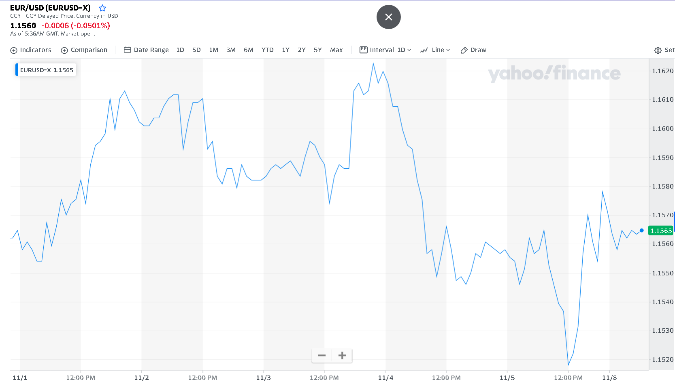
What is Forex Data?
https://finance.yahoo.com/chart/EURUSD%3DX

Slide 3
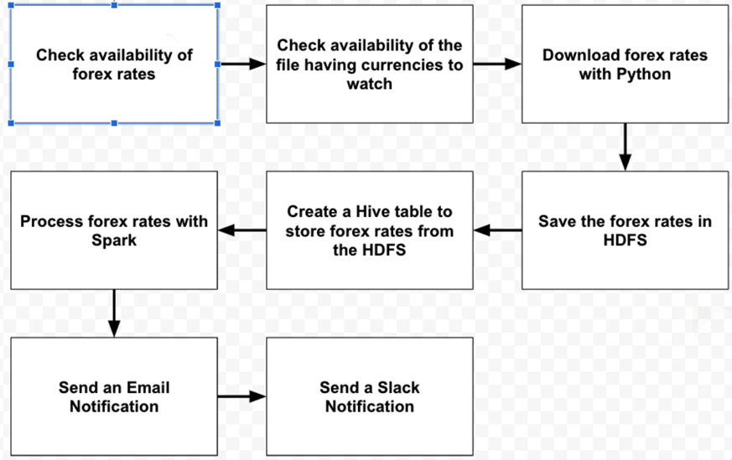
Forex Data pipeline flowchart

Slide 4
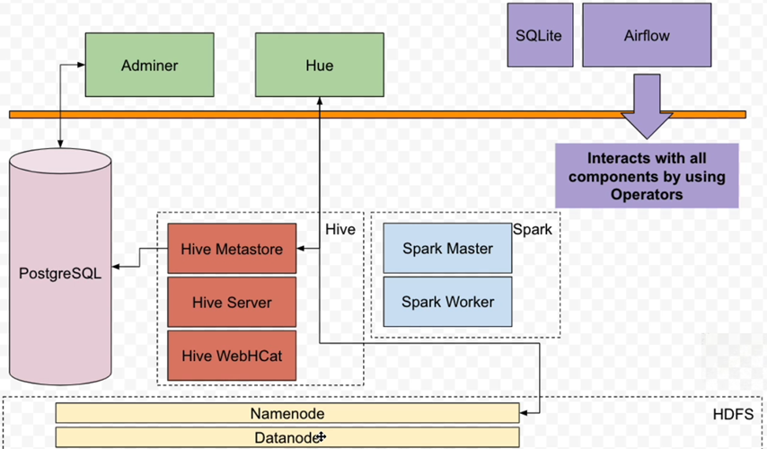
Architecture

Slide 5
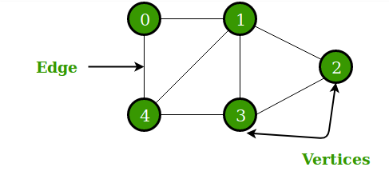
What is DAG?

Slide 6
Thanks

